Slide 1

Artificial Intelligence and Machine Learning
TEXTBOOKS/LEARNING RESOURCES:
a) T. M. Mitchell, Machine Learning (1st ed.), McGraw Hill, 2017. ISBN 978-1259096952.
b) E. Alpaydin, Introduction to Machine Learning (4th ed.), Phi, 2020. ISBN 978-8120350786
REFERENCE BOOKS/LEARNING RESOURCES:
a) Oswald Campesato, Artificial Intelligence, Machine Learning, and Deep Learning (1st ed.), Mercury Learning & Information, 2020. ISBN 9781683924665.

Slide 2
Performance Metrics

Slide 3
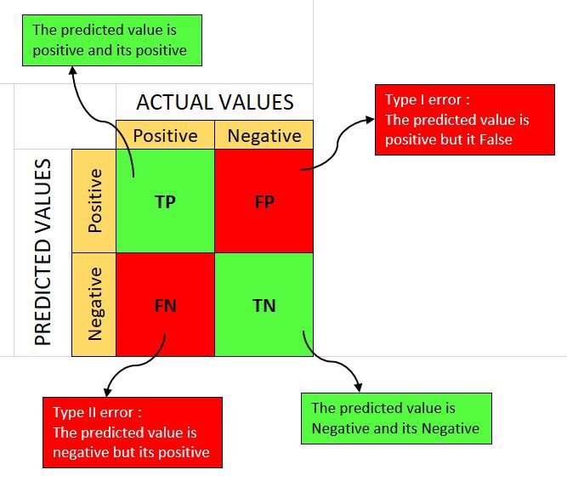
Confusion Matrix
Confusion Matrix

Slide 4
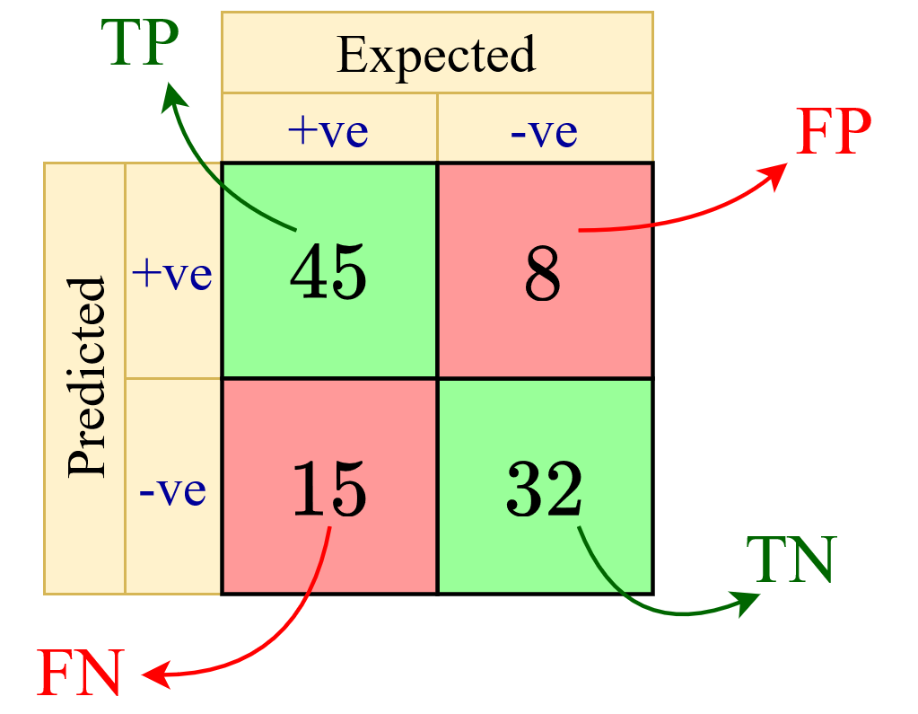
Confusion Matrix
Confusion Matrix
Example of 100 patients (60 positive and 40 negative)
True Positive (TP) refers to a sample belonging to the positive class being classified correctly.
True Negative (TN) refers to a sample belonging to the negative class being classified correctly.
False Positive (FP) refers to a sample belonging to the negative class but being classified wrongly as belonging to the positive class.
False Negative (FN) refers to a sample belonging to the positive class but being classified wrongly as belonging to the negative class.

Slide 5
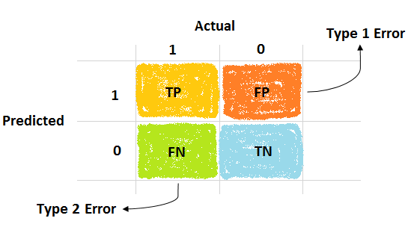
Confusion Matrix

Slide 6
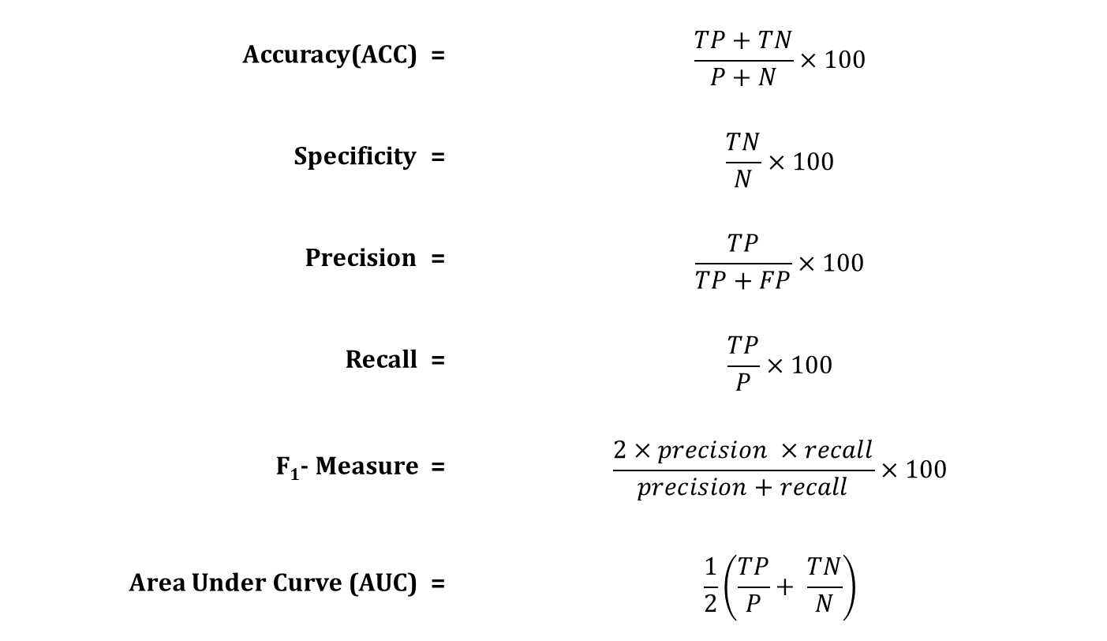
Performance Measures
Accuracy(ACC) = | $$\frac{TP+TN}{P+N}×100$$
Specificity = | $$\frac{TN}{N}×100$$
Precision = | $$\frac{TP}{TP+FP}×100$$
Recall = | $$\frac{TP}{P}×100$$
F₁- Measure = | $$\frac{2×precision ×recall}{precision+recall}×100$$
Area Under Curve (AUC) = | $$\frac{1}{2}\left(\frac{TP}{P}+ \frac{TN}{N}\right)$$
TN
FP
TP
FN
Where, P=TP+FN and N=TN+FP.

Slide 7
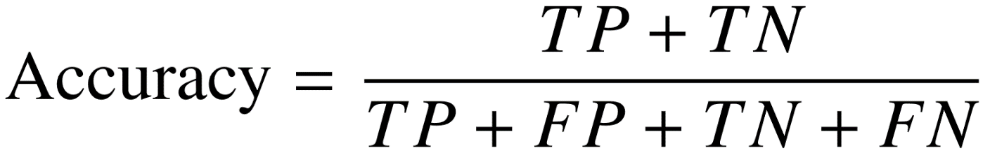
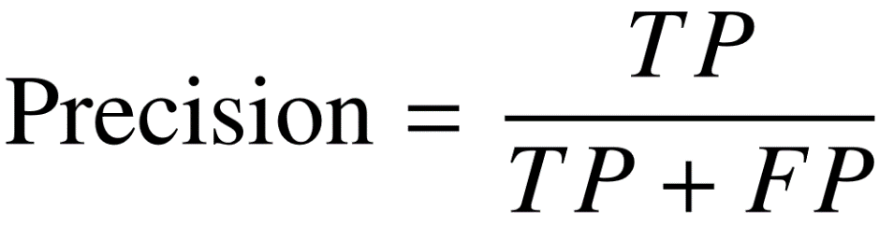
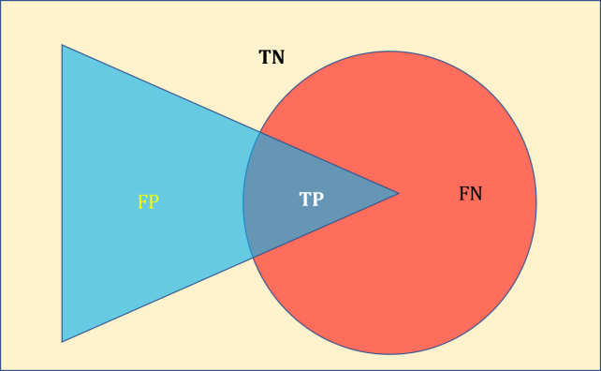
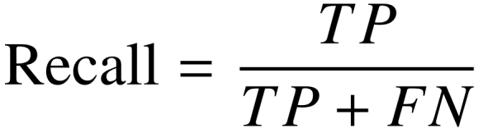
Performance Measures
Accuracy. The number of samples correctly classified out of all the samples present in the test set.
Precision. The number of samples actually belonging to the positive class out of all the samples that were predicted to be of the positive class by the model.
Recall (Sensitivity). The number of samples predicted correctly to be belonging to the positive class out of all the samples that actually belong to the positive class.
What is the test's sensitivity? That is, how many diseased individuals does it correctly identify as diseased?

Slide 8

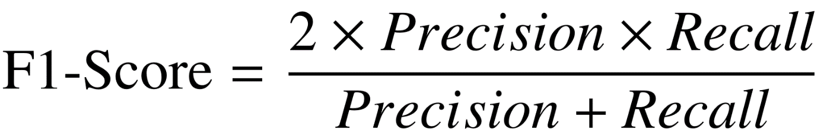
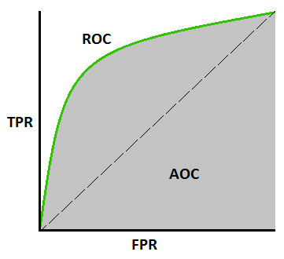
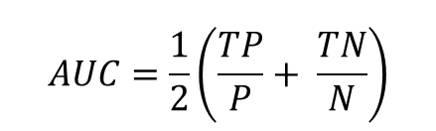
Performance Measures
Specificity. The number of samples predicted correctly to be belonging to the negative class out of all the samples that actually belong to the negative class.
F1-Score. The harmonic mean of the precision and recall scores obtained for the positive class.
AUC or AUROC. is a performance measurement for the classification problems at various threshold settings. Its value ranges between 0 and 1.
What is the test's specificity? That is, how many healthy individuals does it correctly identify as healthy?

Slide 9
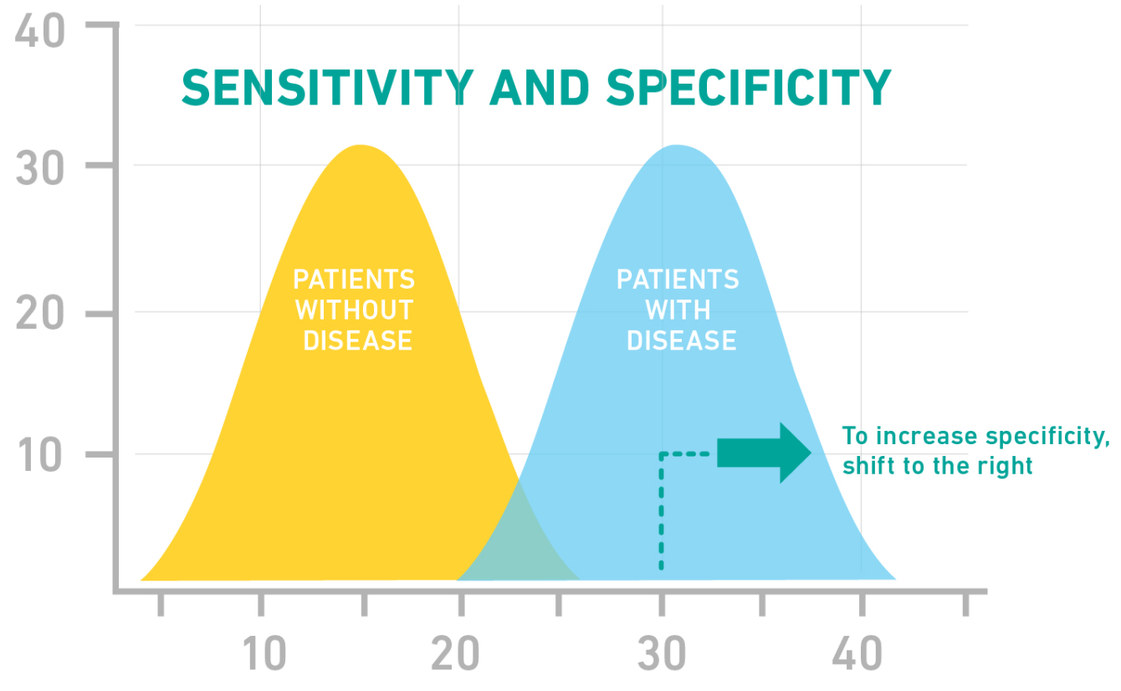
How should I balance sensitivity with specificity?
Sensitivity and specificity of a test are inversely related. Selecting the optimal balance of sensitivity and specificity depends on the purpose for which the test is used.
Generally, a screening test should be highly sensitive, whereas a follow-up confirmatory test should be highly specific.
Sensitivity? How many diseased individuals does the model correctly identify as diseased?
Specificity? How many healthy individuals does the model correctly identify as healthy?

Slide 10
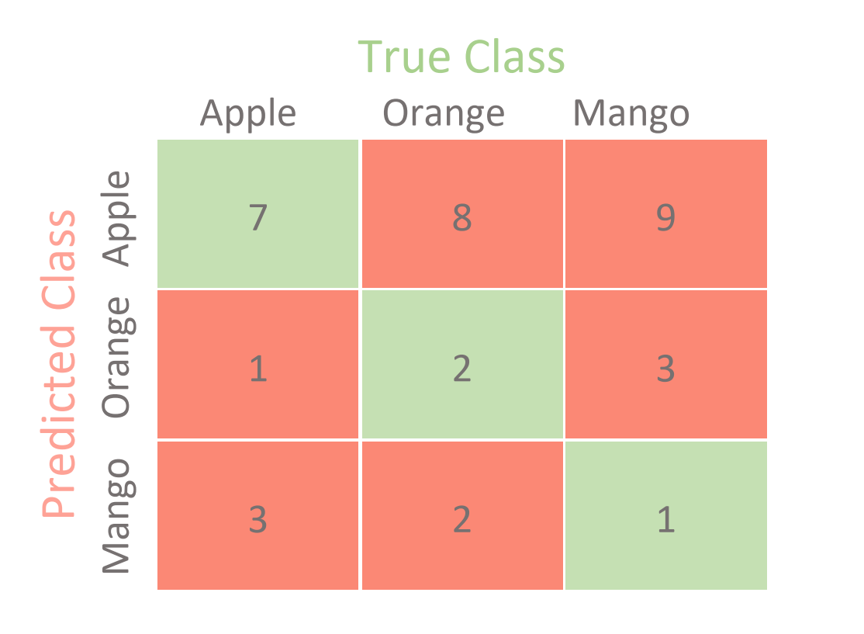
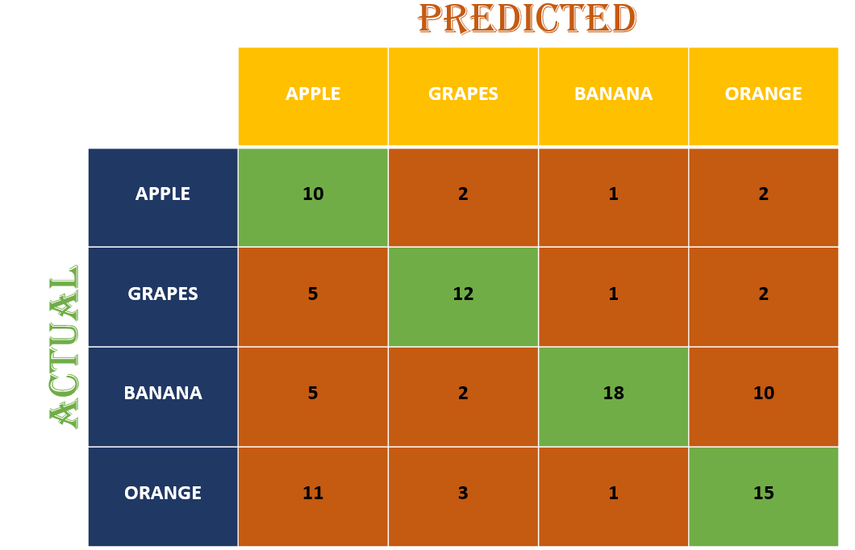
Confusion Matrix
Confusion Matrix for Multiclass Problems
3 Class 4 Class

Slide 11
Confusion Matrix
Confusion Matrix for Multiclass Problems
3 Class 4 Class

Slide 12
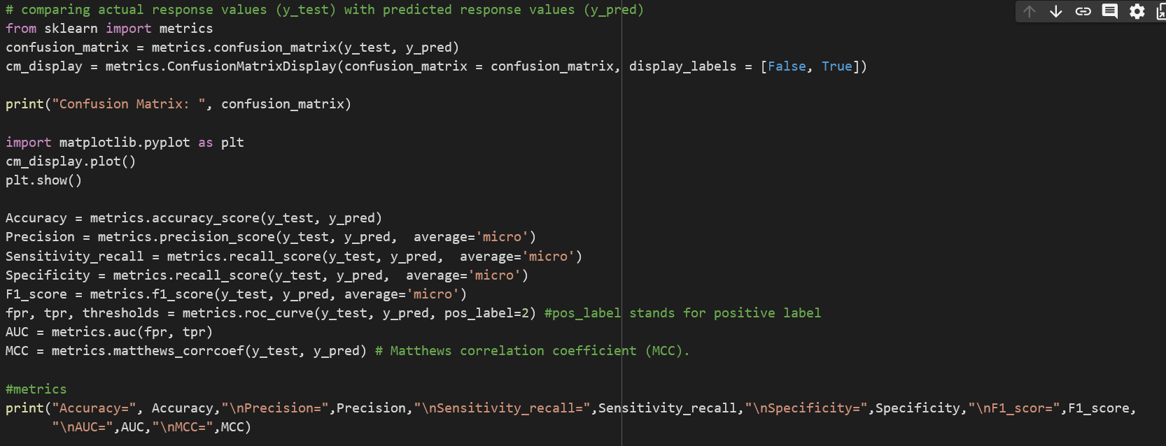

Slide 13


Solve the problem
Consider an example Dataset that consist two category A and B.
Class A having 10 element.
Class B having 10 element .
After building the model, the confusion matrix is given below.
 | A | B
A | 7 | 3
B | 2 | 8
Question 1. Calculate Accuracy Rate
Question 2. Calculate F1 score
Accuracy = (7 + 8) / (7 + 3 + 2 + 8) = 15 / 20 = 0.75 or 75%
Precision = 7 / (7 + 3) = 7 / 10 = 0.7 or 70%
Recall = 7 / (7 + 2) = 7 / 9 ≈ 0.777 or 77.78%
F1-score = 2 * (0.7 * 0.777) / (0.7 + 0.777) ≈ 0.737 or 73.7%

Slide 14
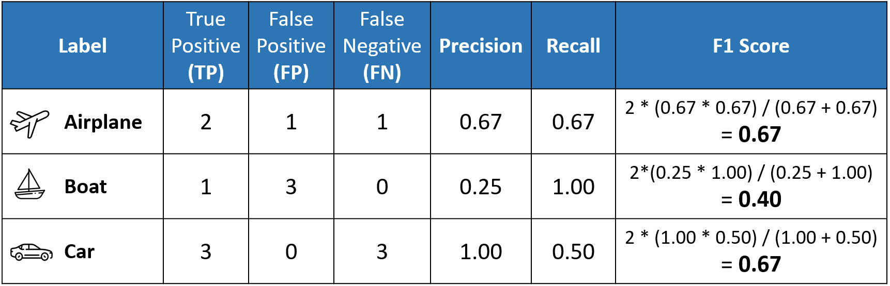
Macro, Micro Average Scores
It is important to remember that in multi-class classification, we calculate the F1 score for each class in a One-vs-Rest (OvR).
However, instead of having multiple per-class F1 scores, it would be better to average them to obtain a single number to describe overall performance.
Macro Averaging, Micro Averaging, Weighted Averaging

Slide 15
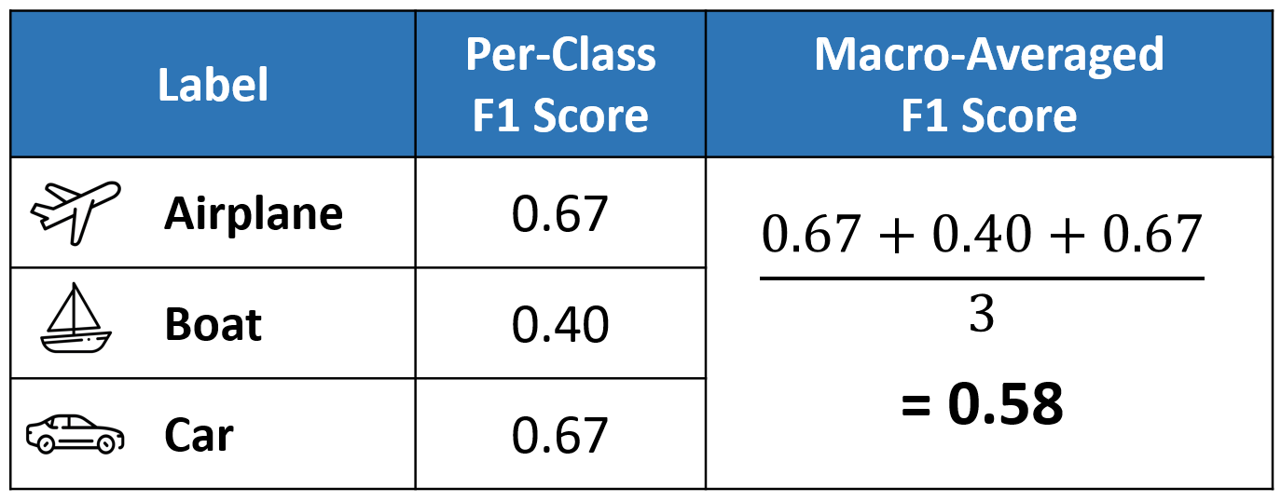
Macro, Micro Average Scores
Macro Average
Macro averaging is perhaps the most straightforward among the numerous averaging methods.

Slide 16
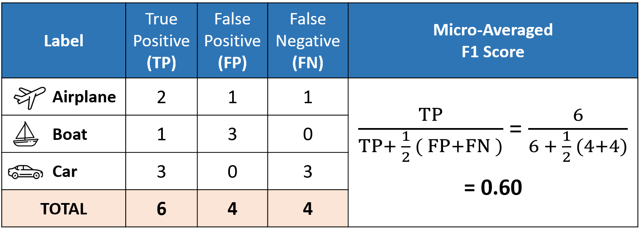
Macro, Micro Average Scores
Micro Average
Micro averaging computes a global average of F1 score by counting the sums of the True Positives (TP), False Negatives (FN), and False Positives (FP)

Slide 17
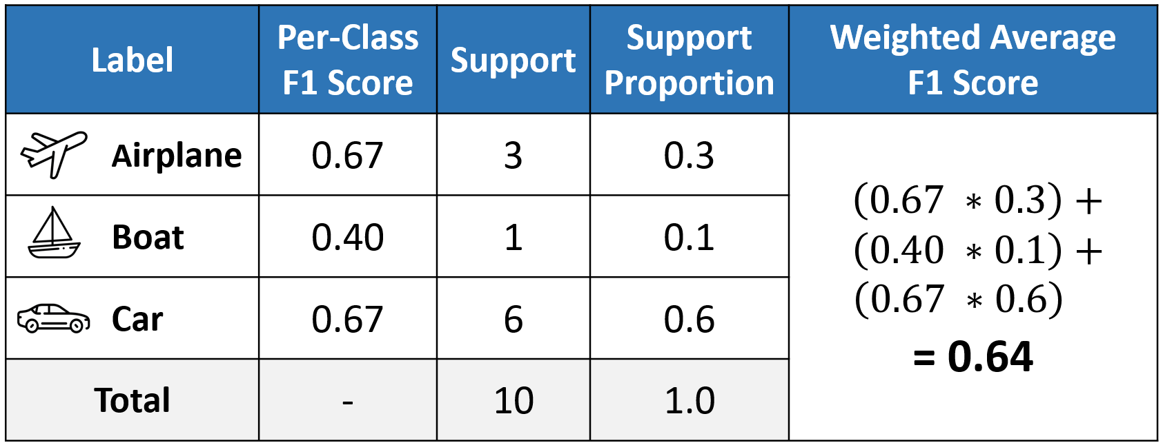
Macro, Micro Average Scores
Weighted Average
The weighted-averaged F1 score is calculated by taking the mean of all per-class F1 scores while considering each class’s support.
Support refers to the number of actual occurrences of the class in the dataset.

Slide 18

Why Accuracy is not a good measure ???

Slide 19
Further Readings:
Confusion Matrix: How To Use It & Interpret Results, https://www.v7labs.com/blog/confusion-matrix-guide
Micro, Macro & Weighted Averages of F1 Score, Clearly Explained, https://towardsdatascience.com/micro-macro-weighted-averages-of-f1-score-clearly-explained-b603420b292f

Slide 20
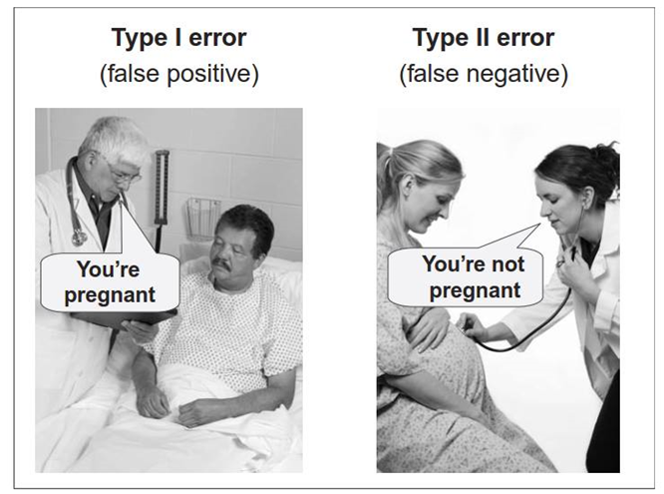
Accuracy Metrics for Time Series Forecast
Accuracy Metrics for Time Series Forecast
https://www.youtube.com/watch?v=prWyZhcktn4

